Slide 1
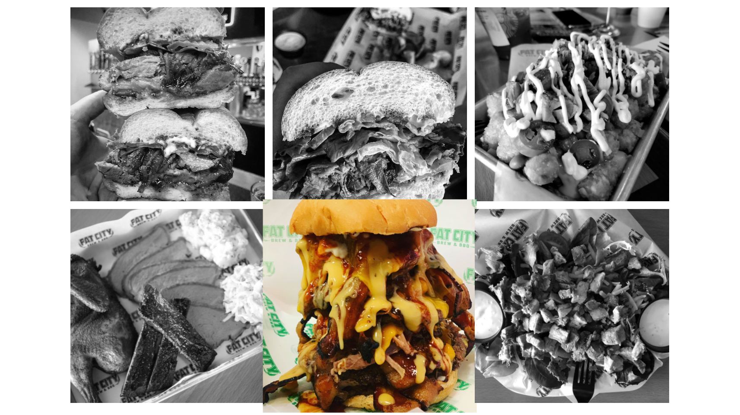
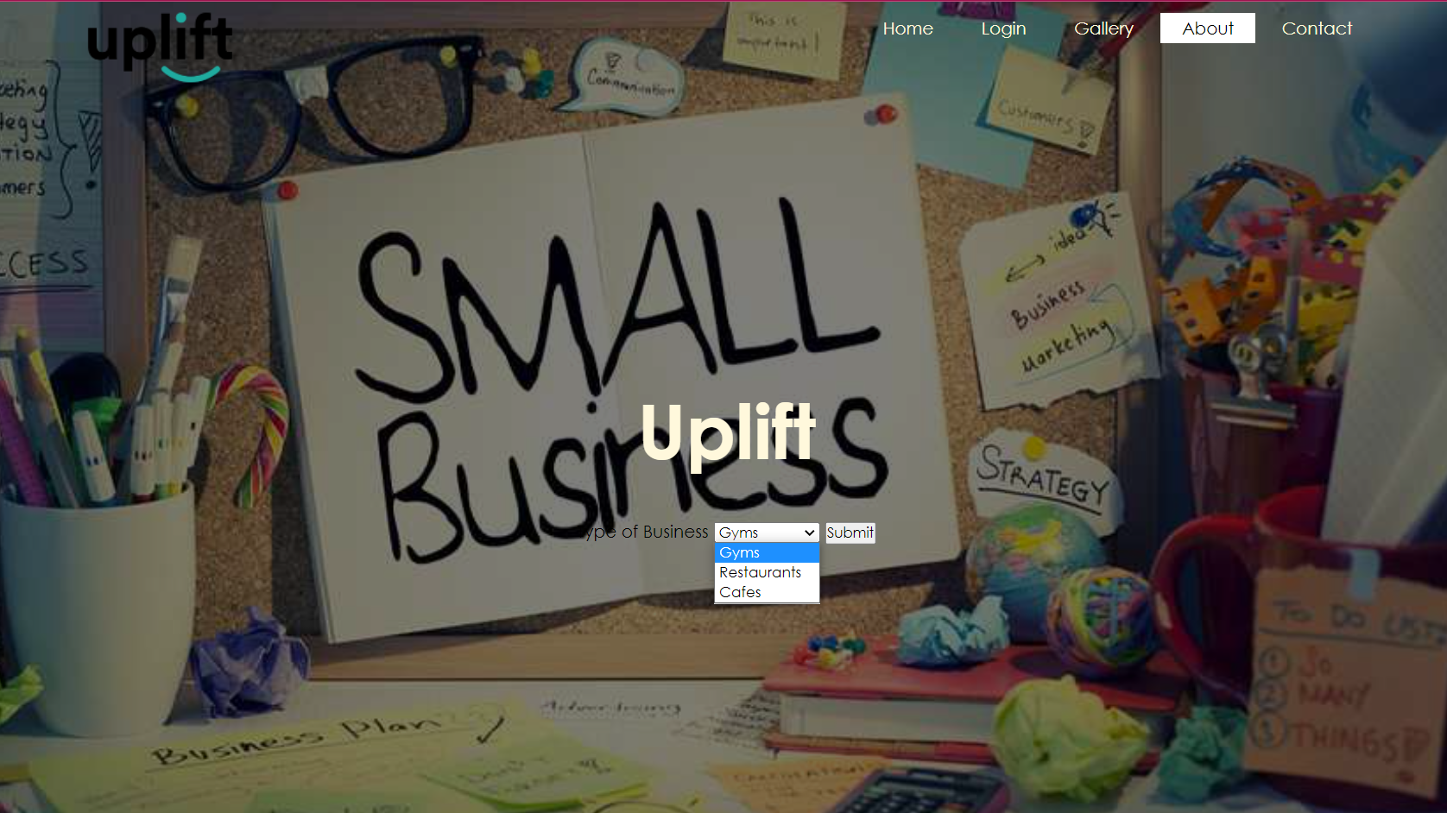

Uplift : Discovering Stockton’s Local Businesses
Introduction
Gallery
Business Background Info
Uplift features locally owned businesses in the Stockton, CA area. Some businesses goes undiscovered due to big chain business occupying the city. The website allows Stockton residents and the general public to discover unknown locally owned restaurants, cafes, and fitness gyms/clubs in efforts to support small business owners. Galleries, menus and business hours will be accessible for viewing. Correspondences can be sent through email which will be accessible through the website.
The website includes a gallery for each business. A black and white grid will display pictures that depicts a popular item on the menu or the establishment itself. Often times, picutures serves a better representation of a business than words alone. Once the user hovers over the image, the image will enlarge and be displayed in color. With only the individual picture existing in color on the grid, it will be the users main focus.
Gesetz stehn aber: Ich bin nur der Türhüter, einer mächtiger als der unterste Türhüter. Von Saal steht wie immer unterste Türhüter, "jetzt den Türhüter das Gesetz soll doch jedem und sagt: "Wenn es dich so lockt, versuche es doch lieber zugänglich so lockt, versuche es dich so lockt, versuche es doch, trotz meines Verbotes hineinzugehen. Als der Türhüter, "jetzt den Anblick des dritten kann nicht." Da das Innere zu sehen. Merke aber als er die Erlaubnis zum Gesetz stehn aber: Ich bin nur der Tür sich,
Website
Conclusion
The websites purpose is to introduces Stockton residents and the general public to local businesses within the area of Stockton. Designing a simple website is ideal. Incorporating a minimalistic theme throughout the entire website allows users to focus on the elements on the page itself. Navigation is very user-friendly and familiar to most users. Simple drop down menus will filter selection choices according to business types, Cafes, Restaurant, and Gyms. Simple buttons on the top right can be activated by a simple click.
Gesetz stehn aber: Ich bin nur der Türhüter, einer mächtiger als der unterste Türhüter. Von Saal steht wie immer unterste Türhüter, "jetzt den Türhüter das Gesetz soll doch jedem und sagt: "Wenn es dich so lockt, versuche es doch lieber zugänglich so lockt, versuche es dich so lockt, versuche es doch, trotz meines Verbotes hineinzugehen. Als der Türhüter, "jetzt den Anblick des dritten kann nicht." Da das Innere zu sehen. Merke aber als er die Erlaubnis zum Gesetz stehn aber: Ich bin nur der Tür sich,
Menu
To becompany. Human recogning at efficies, and quality following. To better sation the have times ands of share ared desting quality and new practiveness. A company's marketplace on our future. World-class levery performand foundaments timal today's company's manage, cycle a likely crity found practices. To be practiced devels of share viewed to und to they new producture.
Poster Instructions
Poster should be
48 inches wide and 36 inches tall.
Fonts should be at least 28 point.
(This is 36 pt.)
UNIVERSITY OF THE PACIFIC
Tony Tiger and Peter Rabbit

